Slide 1
Measurements of Success, Support SLA, Troubleshooting & Escalation Process, & Pricing & Licensing Model
Athziri Vega, Carter Ward, Jeremy Martel, Logan Foster

Slide 2
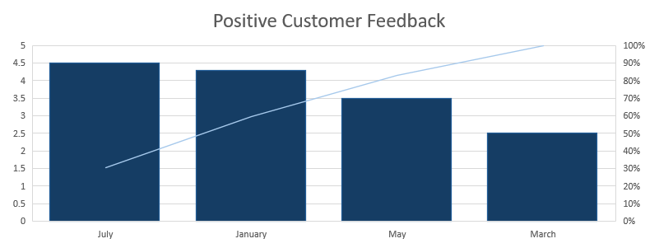
Measurements of Success
Support:
Solving Measurement | Percentage
Solved at First Meeting | 85%
Required Follow Up | 15%
Tickets Received
Tickets Resolved within company guaranteed time

Slide 3
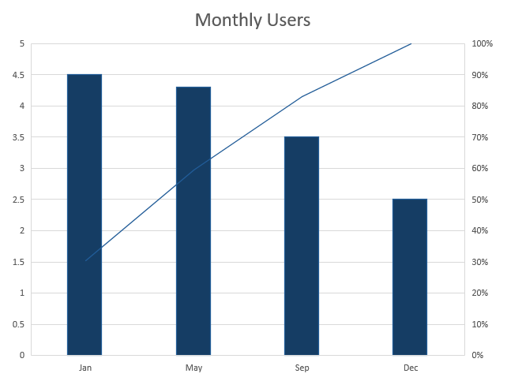
Measurements of Success
Product:
User Return | Percentage
Renewed | 90%
Did Not Renew | 10%

Slide 4
Support SLA
Service and Support
Submitted through a dedicated SEA Support Portal, separate from the general Evisions helpdesk
Monitored Monday through Friday, 6:00 AM to 6:00 PM CT
All requests must include institution name, affected feature area, and expected versus actual behavior
A named support contact assigned to each account within 5 business days of contract signing
Response Priority Tiers
Critical: Dashboard inaccessible or scores not calculating institution-wide. Response within 2 hours, 7 days a week
Significant: Core feature broken but platform accessible. Response within 4 business hours
Moderate: Data displaying incorrectly, filter returning inconsistent results. Response within 2 business days
Informational: Navigation questions, feature clarification, non-urgent configuration. Response within 4 business days
Platform Availability and Integrations
99.7% monthly uptime guaranteed; clients receive a 5% billing credit per full percentage point below the threshold due to an Evisions-side failure
Planned maintenance scheduled weekends between 11:00 PM and 3:00 AM CT with 5 business days advance notice
Evisions monitors all managed integration pipelines and notifies clients within 3 business hours of a detected sync failure
Clients receive a monthly integration health report covering sync success rates, data latency, and incidents
Failures originating in the institution's own campus systems are outside scope

Slide 5
Support SLA (Cont.)
Support Inclusions and Exclusions
Included: engagement score errors, at-risk flagging and filter logic, events and club meeting data, referral workflows, and onboarding support within the first 90 days post-implementation
Excluded: data accuracy issues from third party systems, custom scoring changes post-implementation, FERPA disputes, staff training on data interpretation, and any platform modifications made without Evisions' written approval
Version Support and Client Responsibilities
Current release and one prior minor version supported; quarterly minor releases, one major release per academic year before fall semester
60 days advance notice before any version moves to unsupported; clients on unsupported versions are ineligible for Critical and Significant tier response
Client must maintain active integrations, notify Evisions 15 business days before any upstream system changes, and designate at least one internal SEA administrator
Extended coverage available at 12% of annual license fee for weekend Critical and Significant tier response

Slide 6
Troubleshooting & Escalation Process
Step 1: Intake and Triage
Confirm request includes institution name, affected feature area, and expected versus actual behavior before beginning
Assign priority tier (Critical, Significant, Moderate, Informational), start the response clock, and log in the SEA Support Portal
Step 2: Analyst Troubleshooting
Engagement Scores: Confirm last sync for all integrations, check if issue is institution-wide or isolated, verify filters are not skewing averages, confirm nightly recalculation job completed
At-Risk List: Verify no unintended filters are stacked, confirm threshold configuration is active, search for missing students directly
Events: Check Date and Reserved filters, confirm event is published and active in the source system, verify last sync timestamp
Step 3: Escalation Paths
Tier 1: Senior Support Analyst → Analyst completed all checks, root cause still unknown; hand off full notes, steps taken, and screenshots
Tier 2: Data Engineering → Suspected pipeline failure or sync error; hand off integration health data, sync timestamps, and affected data source
Tier 3: Software Engineering → Confirmed platform bug or regression; hand off reproducible steps, SEA version, and a drafted Jira ticket
Tier 4: Product → Issue reveals a product gap or missing feature; hand off client use case summary and frequency across the client base
Step 4: Client Communication and Closure
Acknowledge every ticket within the SLA window; send daily status updates while open; never commit to a resolution timeline without engineering confirmation
Close only after client confirms resolution or after 5 business days of no response; log root cause, resolution steps, and escalation path before closing

Slide 7
Pricing & Licensing Model
Basic version would be a licensed model, yearly with a discount for signing up for more than 1 year.
Basic/certain amount of time support included in any version.
Advanced/longer required support might be charged, would be dependent on the need shown and work required.
Bundle with other Evisions products likely, especially if applications can work together.
Different prices for school size possible, would depend on if larger schools would take a notably larger amount of resources to support on our end.
Paid virtual trainings available later after employees were comfortable enough to be able to train in the application, and any potential major issues had been ironed out.

